Slide 1
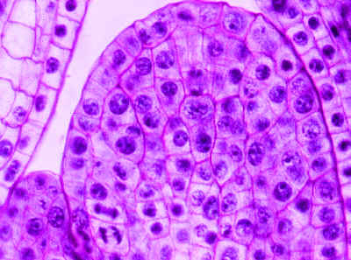
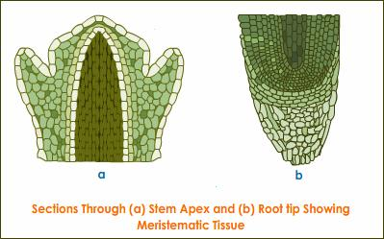
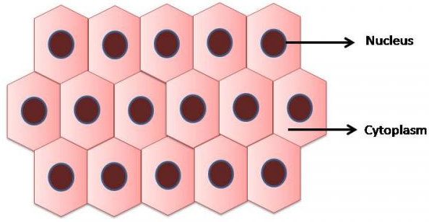
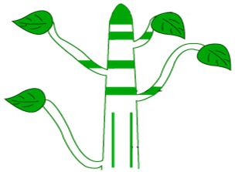
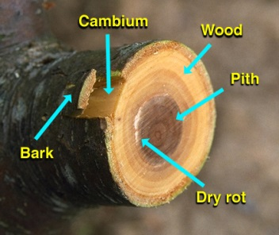
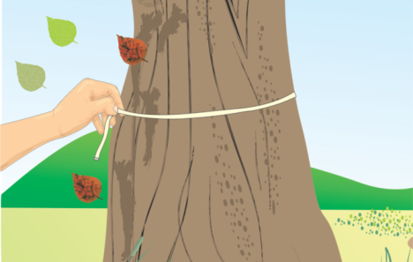
MERISTEMATIC TISSUES
Meristematic tissue is the only plant tissue that produces new cells by cell division.
These cells are thin walled with conspicuous nucleus and divide rapidly.
Depending upon the region where they are situated meristematic tissues are classified as :
Apical meristem :
Lateral meristem :
Intercalary meristem :
Easily seen
Let us study them one by one
It is located at the growing tips of stem and roots.
It enables the root or stem to grow in length.
It is also called as cambium.
The girth and width of the stem or the root increases due to lateral meristems.
Apical meristem
It is present at the base of the leaves,
The cells of this tissue have dense cytoplasm, thin cellulose walls and prominent nuclei.
These cells are very active.
at the nodal region of the twigs
Intercalary meristem
The region where branches arise
Branches
Thick
Lateral meristem
A type of carbohydrate
Clearly visible

Slide 2
PERMANENT TISSUES
are further classified as :
The cells formed by the division of meristematic tissue take up a specific role and lose the ability to divide.
This process of taking up permanent shape, size and a function is called differentiation.
Simple permanent tissues
Complex permanent tissues
As a result, they form permanent tissue.
Simple tissues are of 6 types :
Made up of more than one type of cells
Parenchyma
Made up of one type of cells
Complex tissues are of 2 types :
Xylem
Chlorenchyma
Phloem
Aerenchyma
Collenchyma
Sclerenchyma
Surface tissue (Epidermis)
Let us study them one by one

